Slide 1
BCC
24-Sept-2019
Mark FUller, Kevin Kulda, Connor Woodahl,
Professor: Dr. Cerny

Slide 2
Product Vision
BCC is a tool used by students to rate their current teachers, view reviews of future teachers and contact previous students who have had those teachers

Slide 3
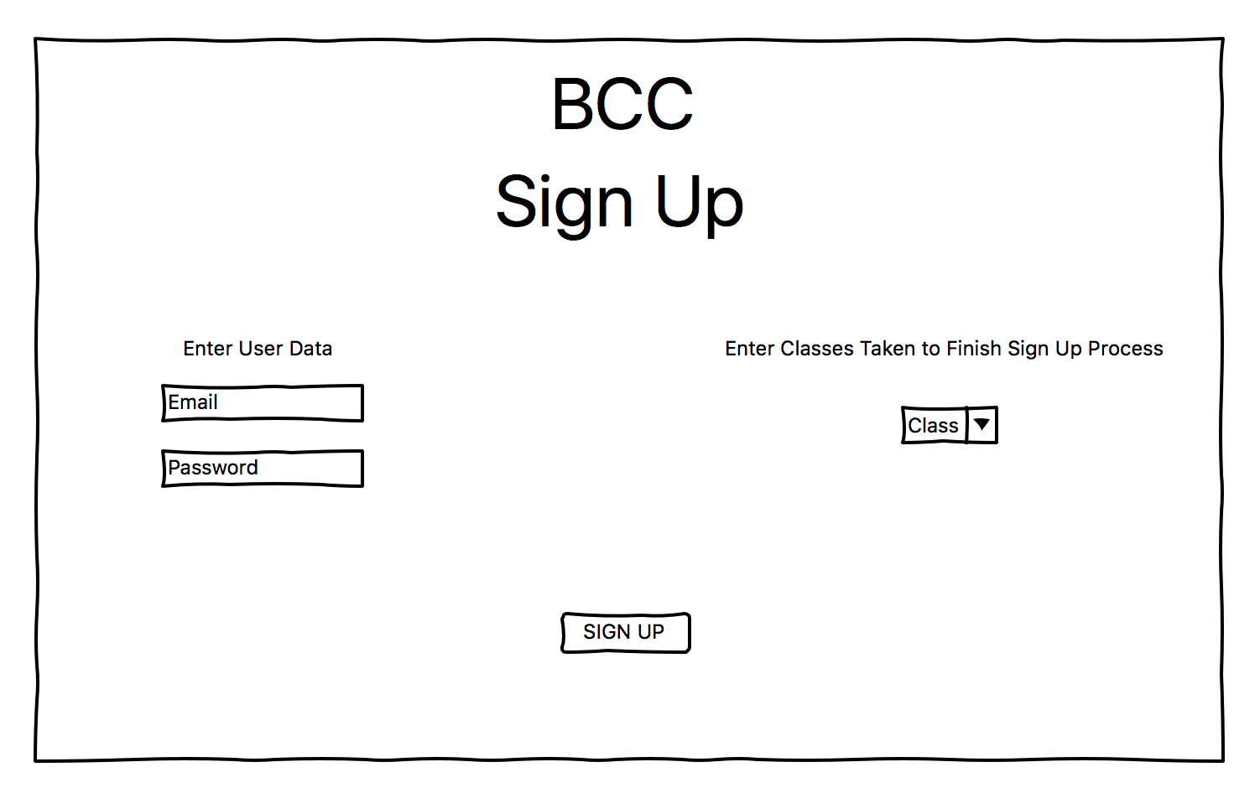
Wireframes

Slide 4
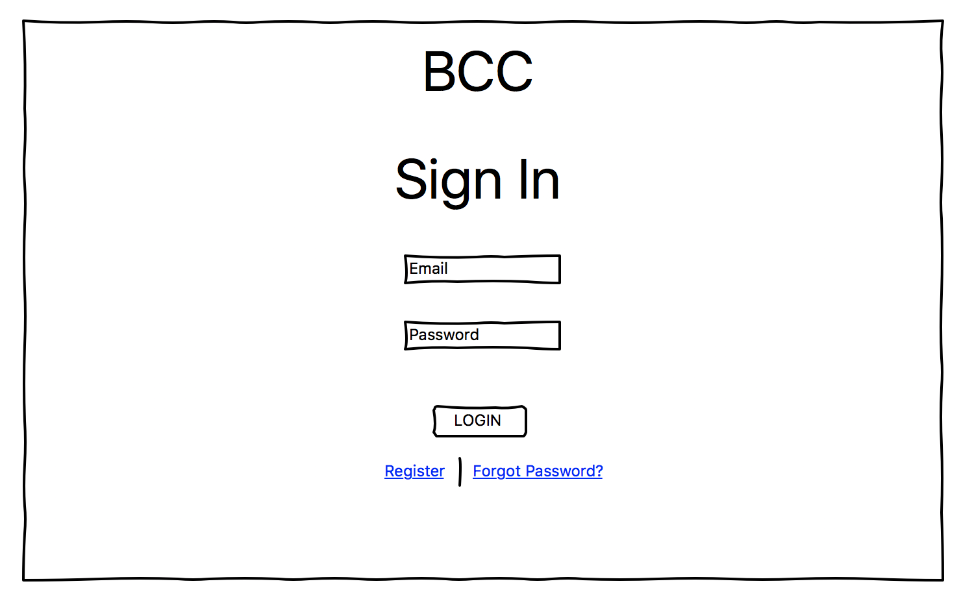
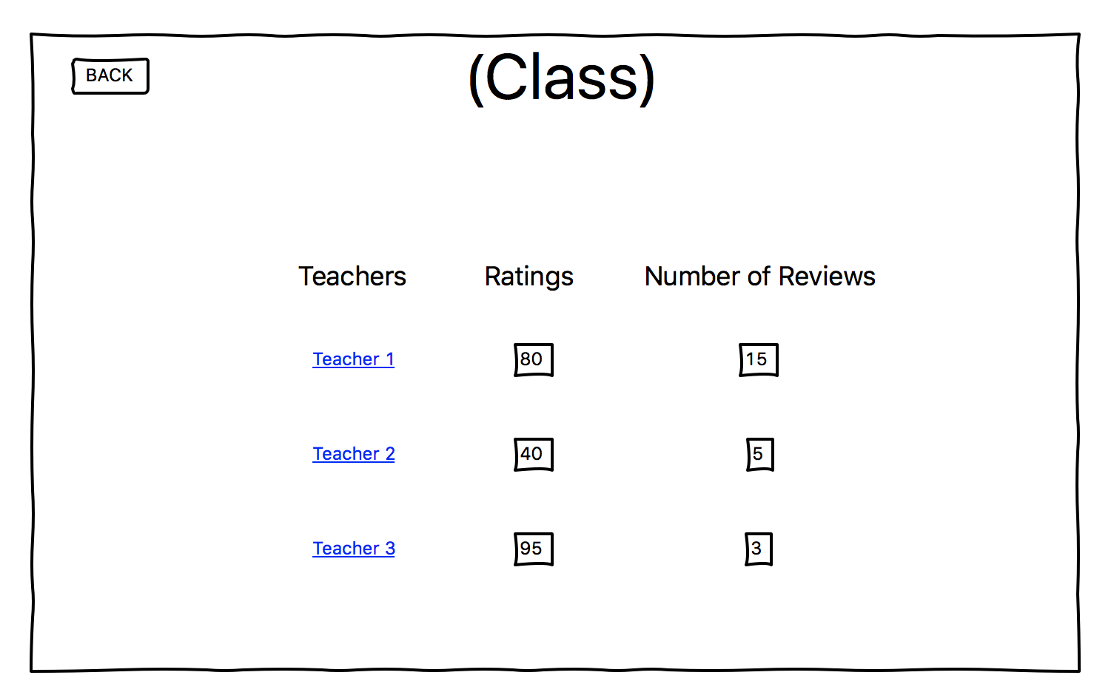
Wireframes
https://github.com/MarkFuller1/BNU/blob/master/docs/WireScreenShots/Screen%20Shot%202019-09-16%20at%209.29.44%20PM.png https://github.com/MarkFuller1/BNU/blob/master/docs/WireScreenShots/Screen%20Shot%202019-09-16%20at%209.29.44%20PM.png

Slide 5
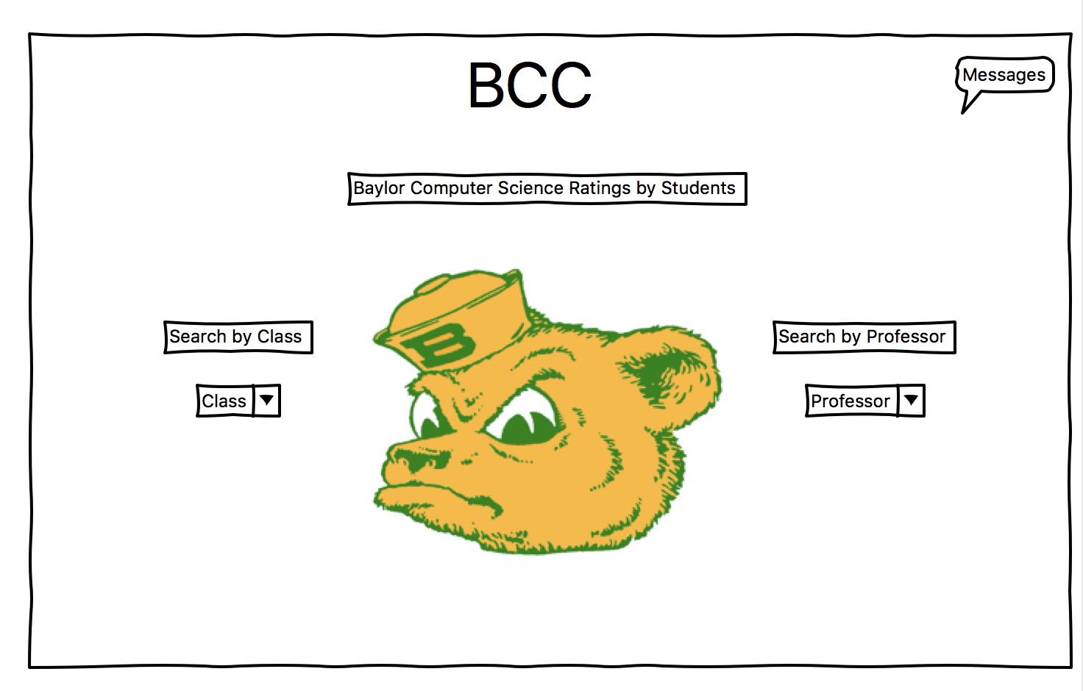
Wireframes

Slide 6
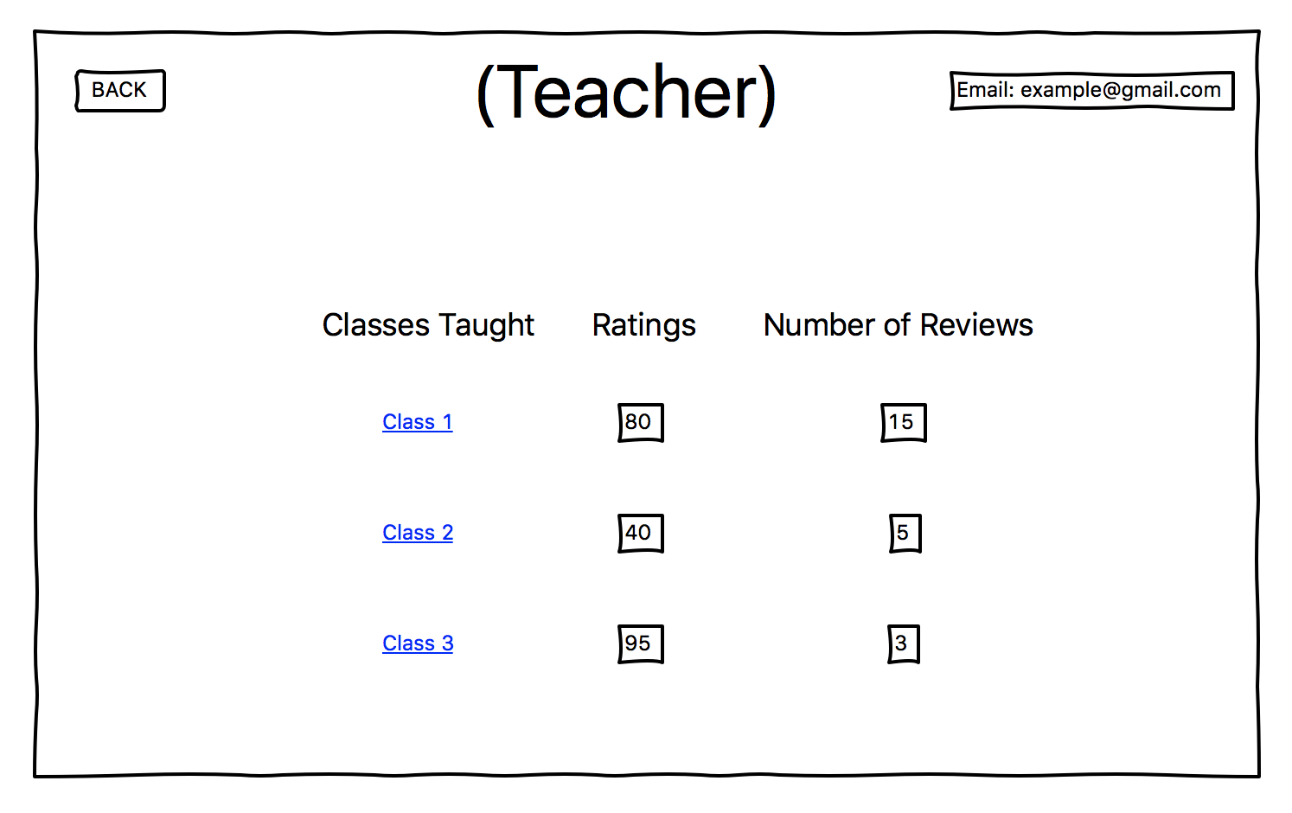
Wireframes

Slide 7
Wireframes

Slide 8
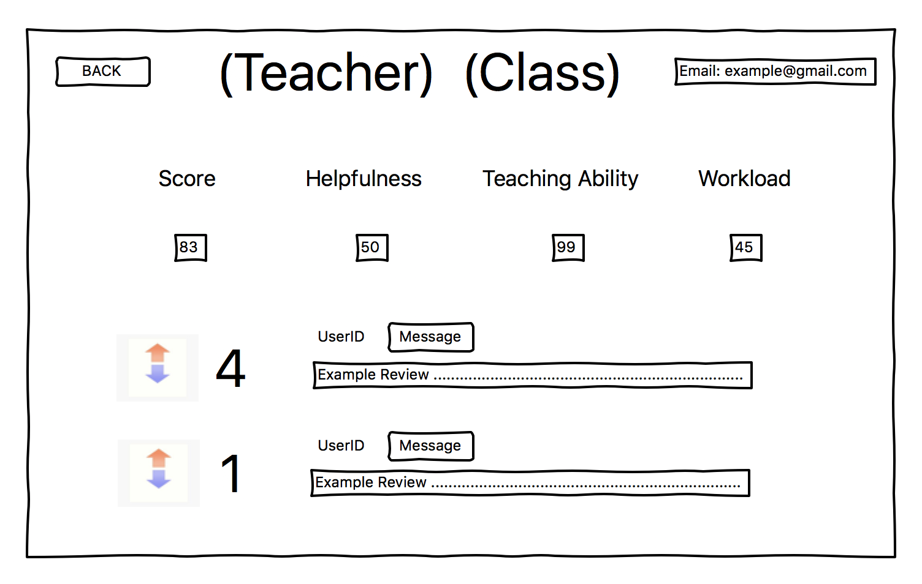
Wireframes

Slide 9
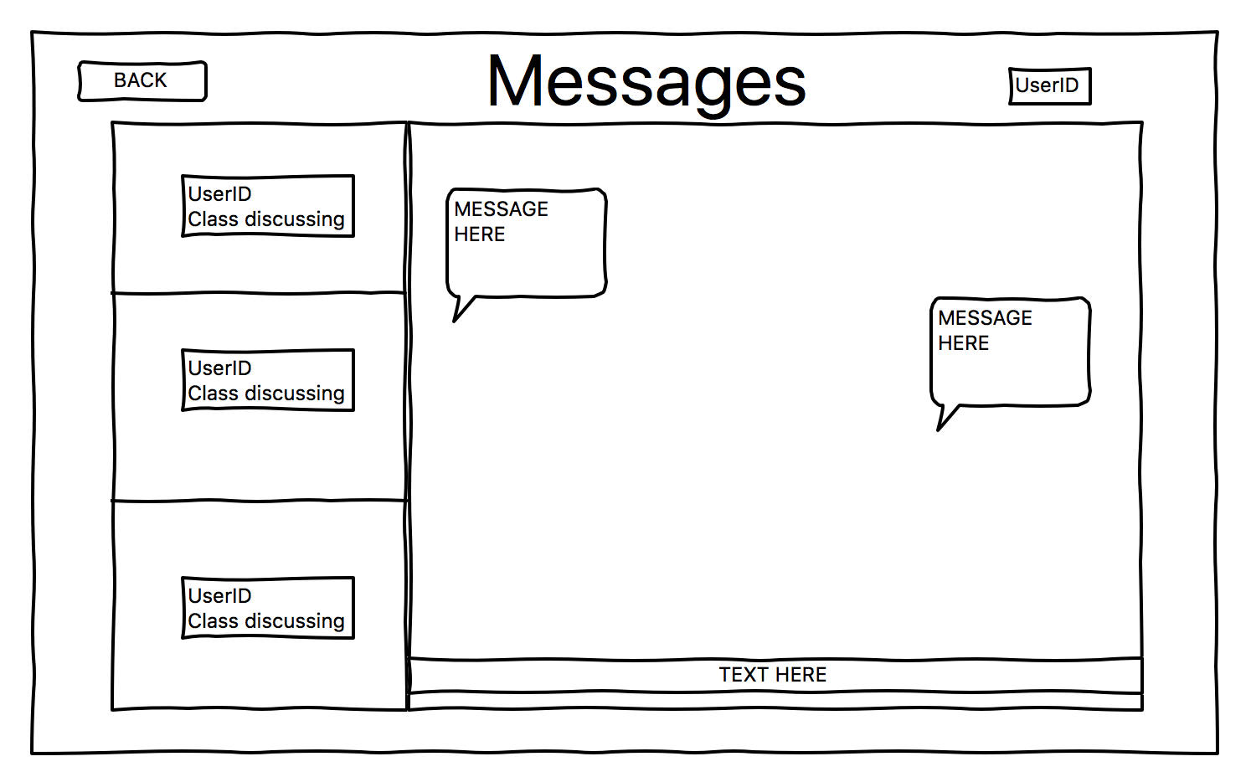
Wireframes

Slide 10
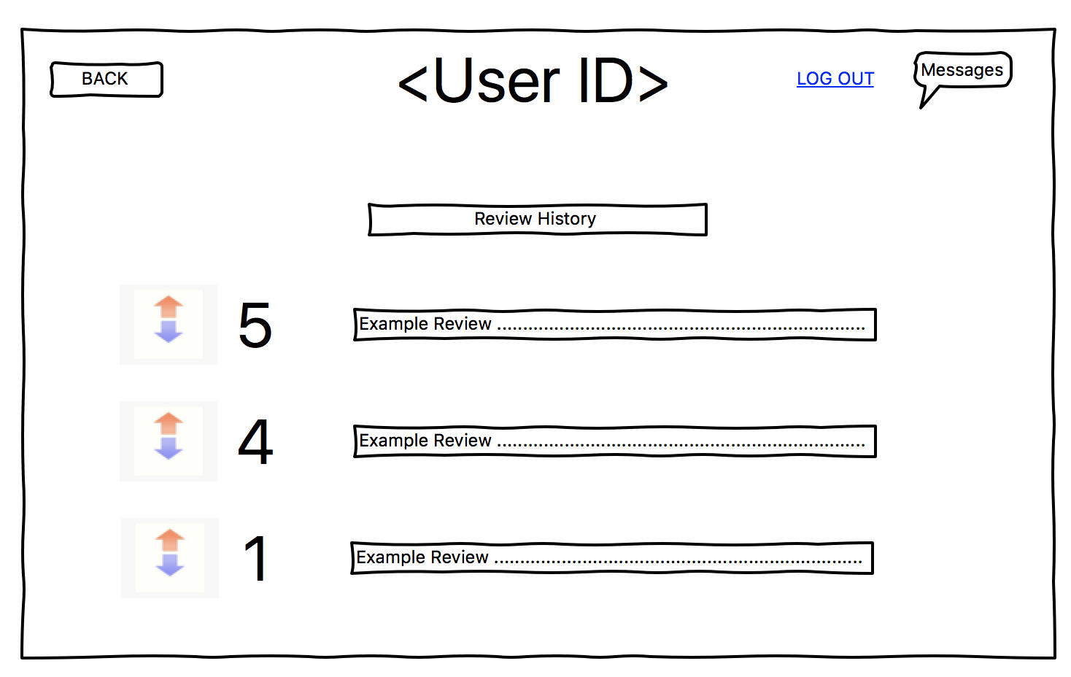
Wireframes

Slide 11
Requirements
Functional Requirements
Users need to be able to register an account.
Users must be able to search based on class.
Users must be able to see professor options after searching the class.
Users must be able to search based on professor.
Users must be able to write a review on a professor.
Users must be able to upvote or downvote a review.
Users must be able to send a message to the author of the review.
The reviewer must be able to respond to a message.
User must be able to log out.
The application must be able to sanitize user input.
User must be able to navigate bidirectionally in this application.
Users need to be able to delete an account.
Users must be able edit a review.
Non-Functional Requirements
Messages must be able to be sent anonymously
User data must be kept private
Application must be fast for the average user
Application must handle traffic of at most 20 users at once
User interface should be intuitive
User interface should be graphically pleasing

Slide 12
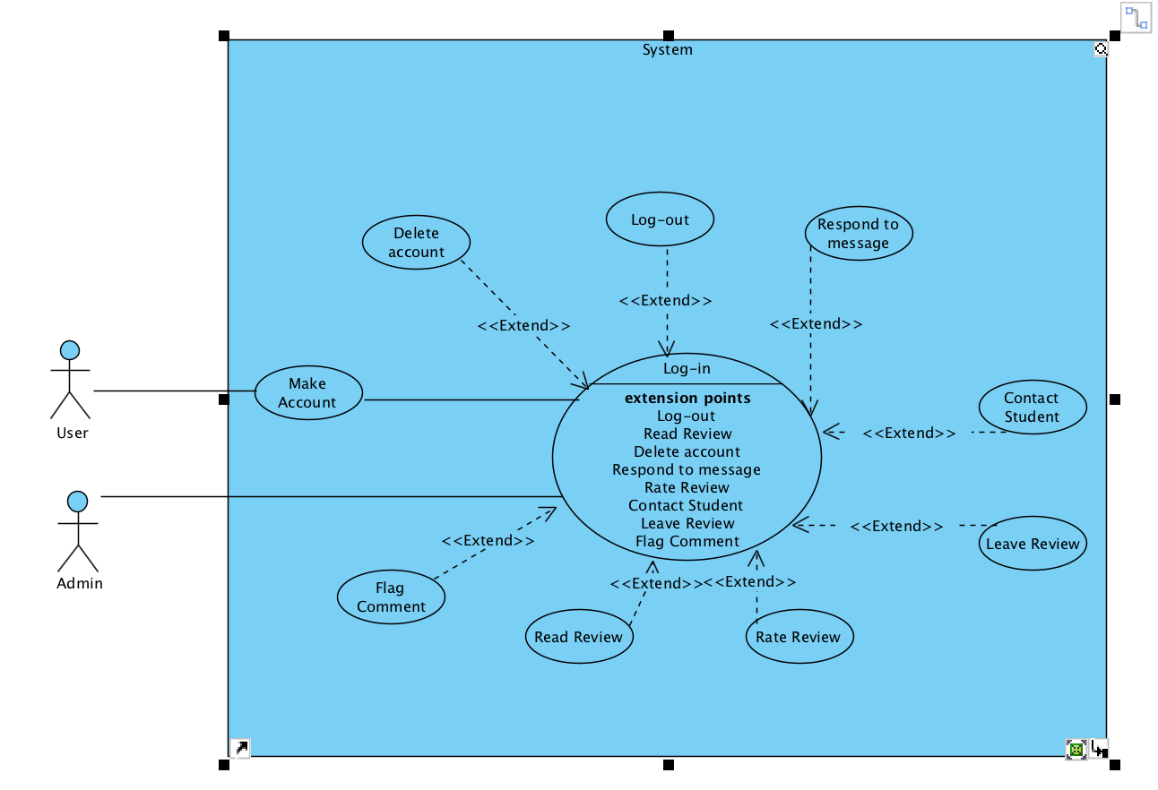
Use Case Diagram

Slide 13
Git Hub page
Please see our Github page for the current versions of our development materials and the full repository of our project artifacts.
https://github.com/MarkFuller1/BNU/

Slide 14
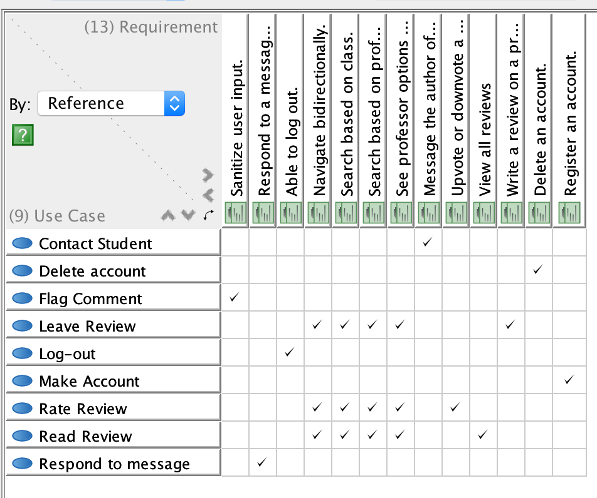
Traceability Matrix

Slide 15
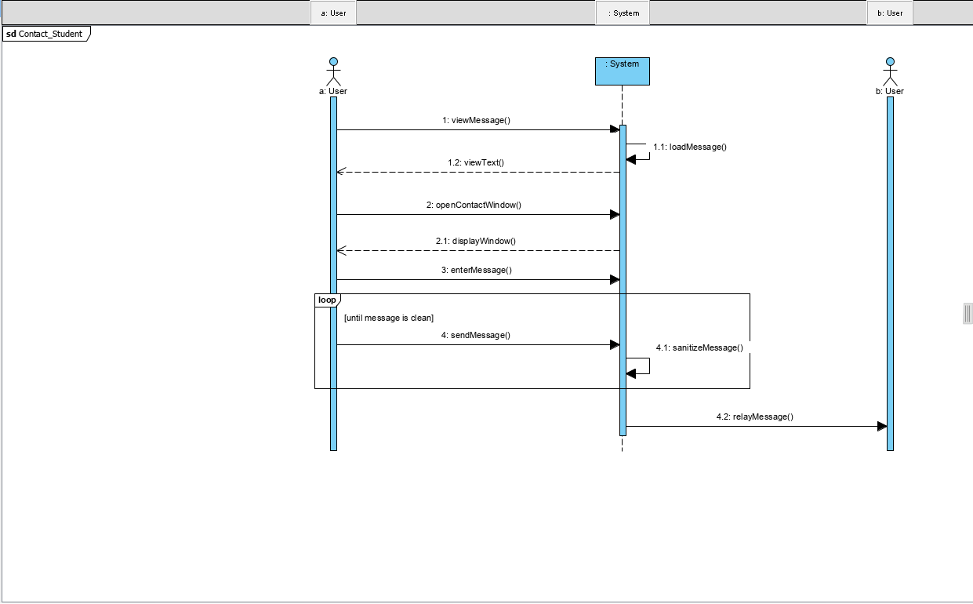
SSD

Slide 16
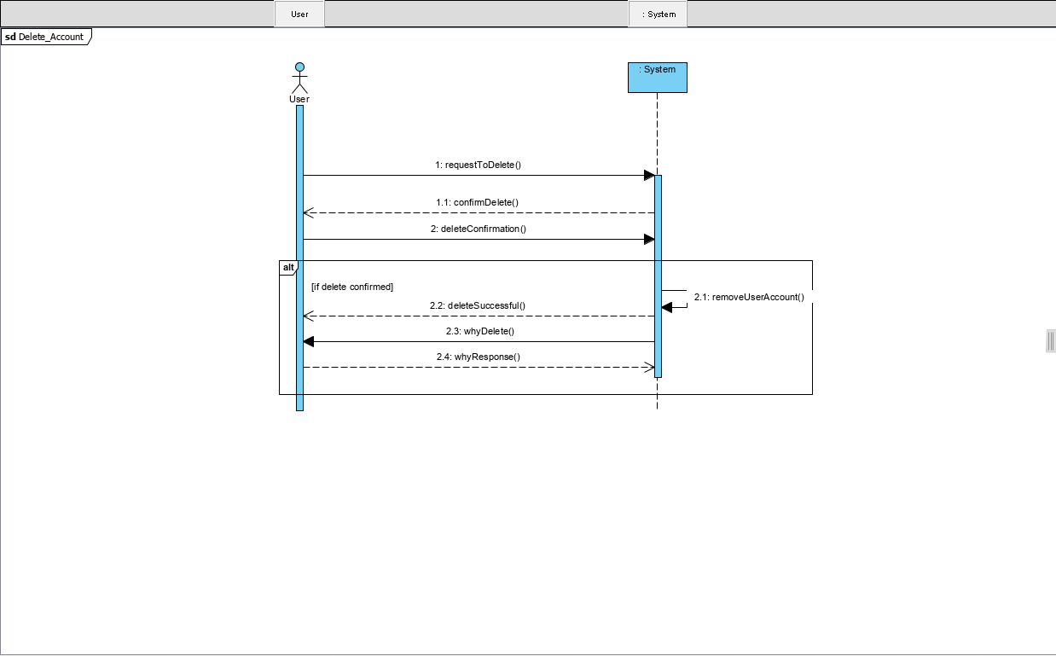
SSD

Slide 17
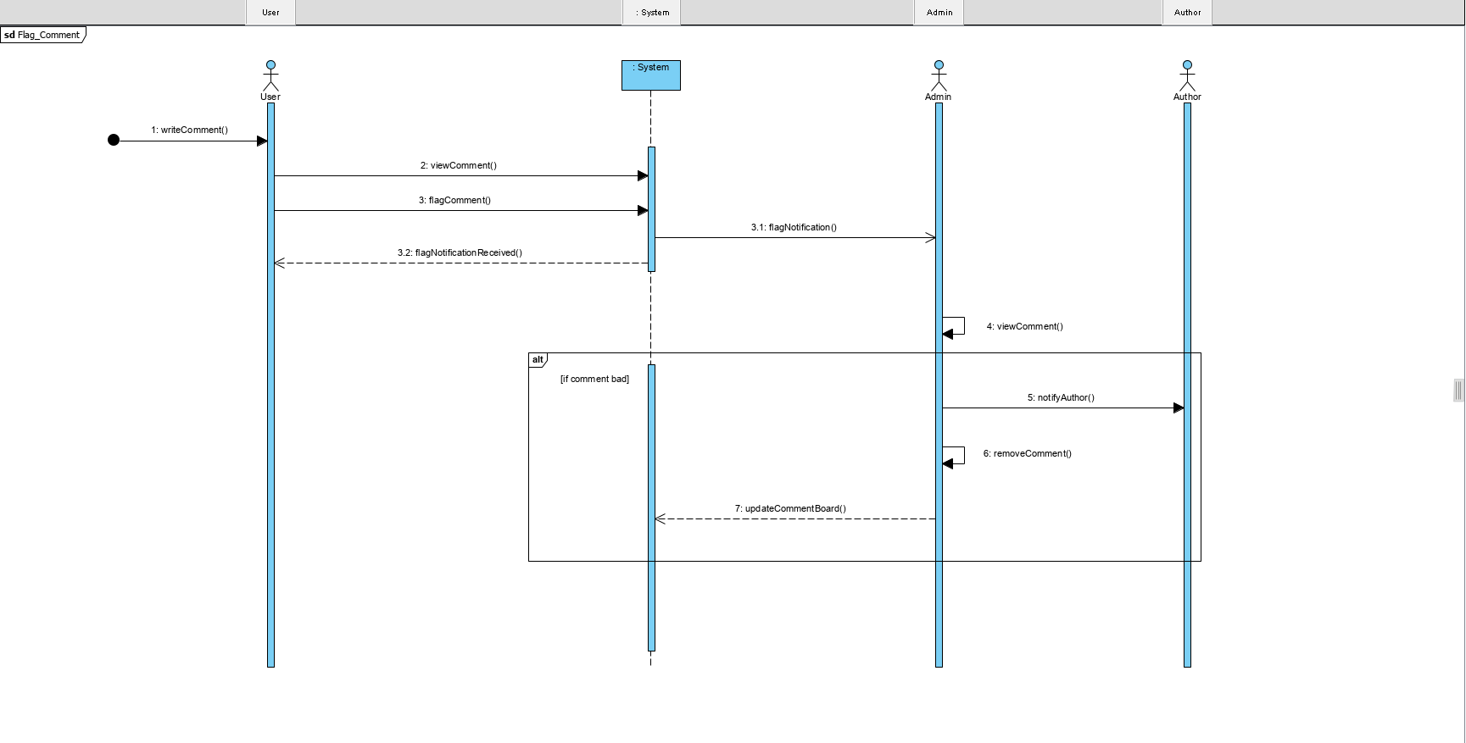
SSD

Slide 18
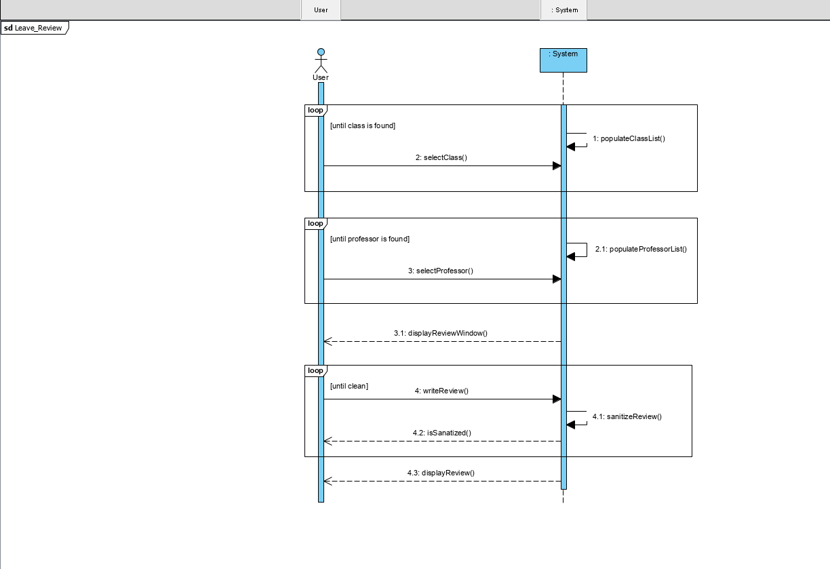
SSD

Slide 19
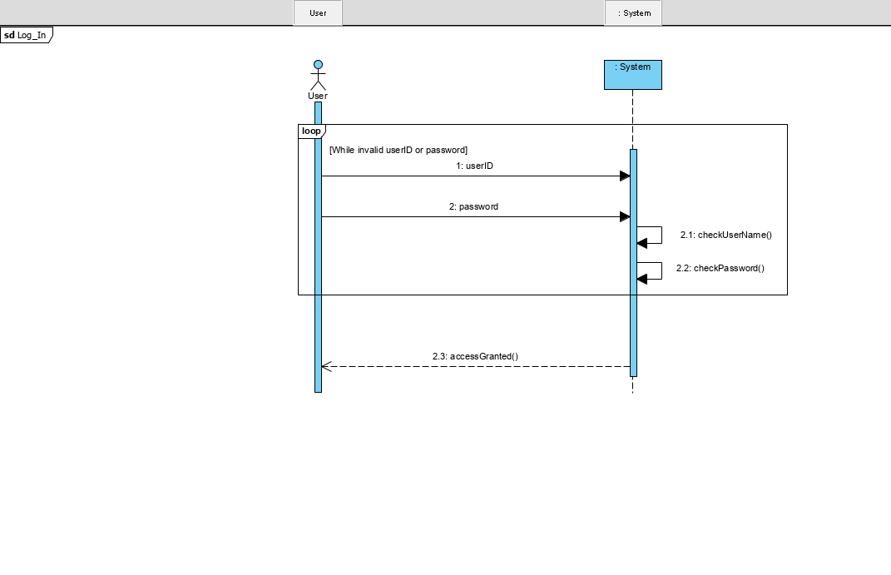
SSD

Slide 20
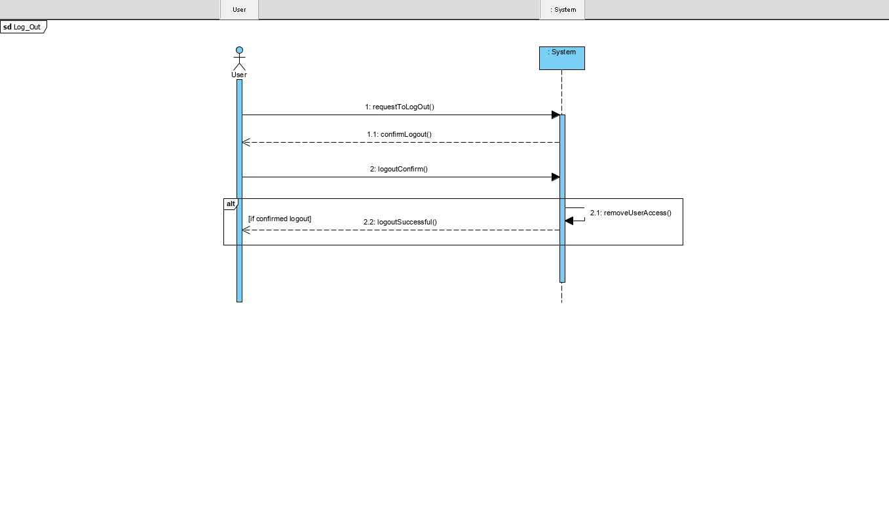
SSD

Slide 21
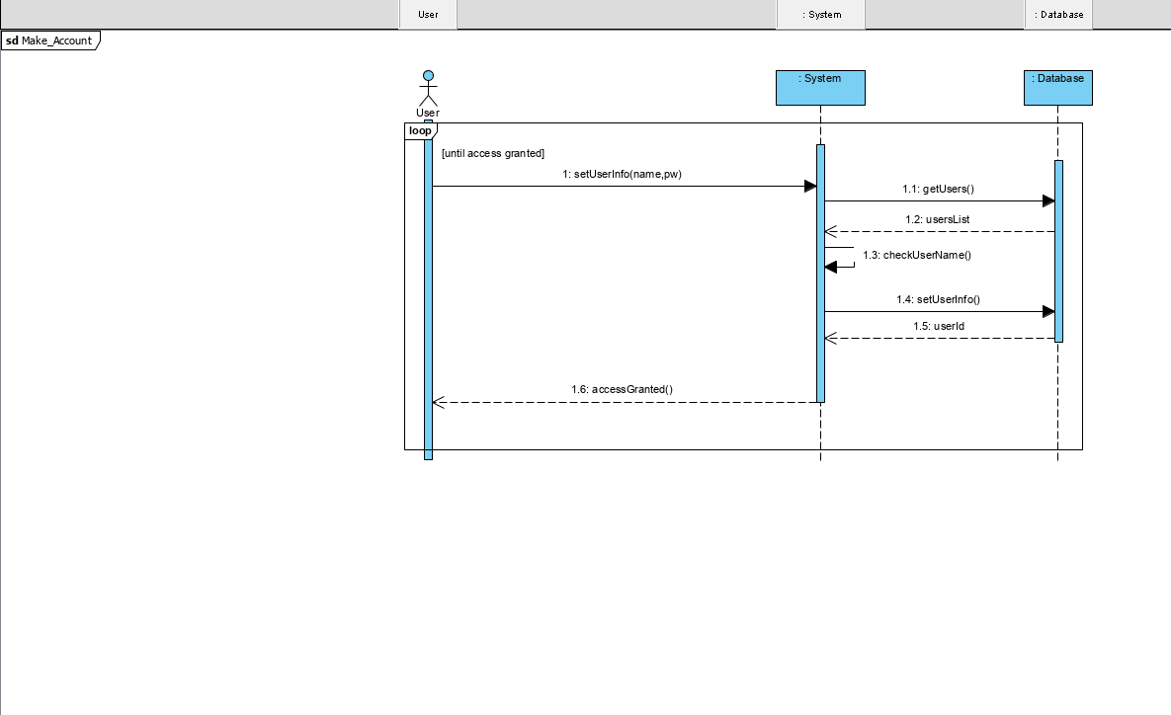
SSD

Slide 22
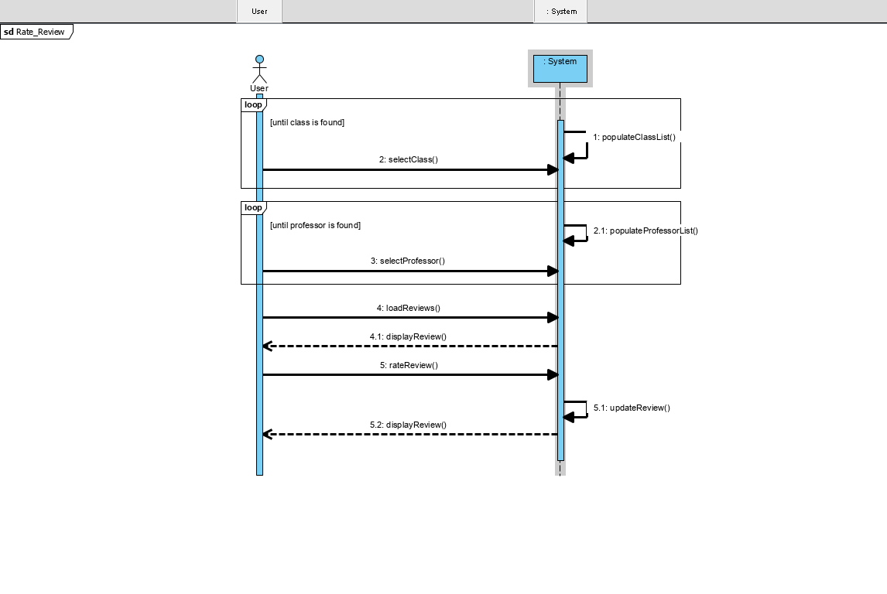
SSD

Slide 23
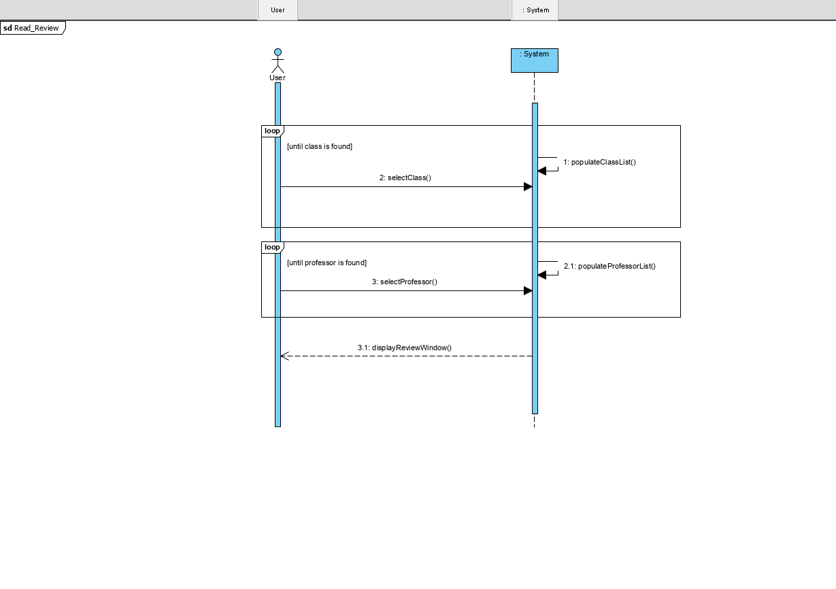
SSD

Slide 24
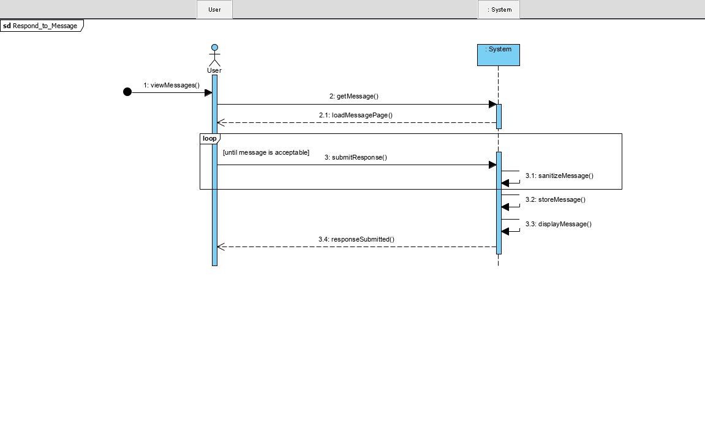
SSD

Slide 25
OPERATIONS
Defining the system operations helps us plan how we will implement the BCC application.
Examples
checkUsername()
checkPassword()
populateClassList()
populateProfessorList()
sendMessage()
viewMessage()
There are ~70 more ☺

Slide 26
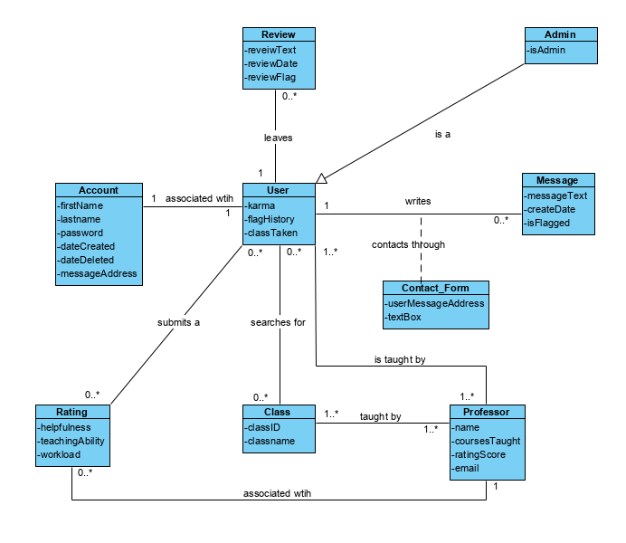
Domain MOdel

Slide 27
Questions?

Slide 28
Use Case Division
Use Cases handled by Kevin– Make Account, Respond to a Message, Flag Comment
Use Cases handled by Mark – Leave Review, Rate Review, Read Review
Use Cases handled by Connor – Contact Student, Edit Review, Delete Account, Log Out

Slide 29
Make an account
Make an Account
Scope: GCC Application
Level: User Goal
Primary Actor: Student
Stakeholders and Interests:
Student User: Wants username and password stored and hashed for security.
Preconditions: Student has loaded the site
Success Guarantee: Students data is hashed and saved into database. Immediate access to the application is granted.
Main Success Scenario:
Student loads application.
Student requests a new account.
Student enters Username, Password and, email, etc.
System updates valid students list with new student.
Student Logs in.
Alternative Flows:
a. At any time the student closes the application.
1. Interaction ends.
b. At any time system fails.
1. Student will restart application.
c. While student is on register page, they would like to login with valid credentials(the realized they had an account already)
1. Student clicks `return to login` and logs in with valid username and password.
d. Username and password from account creation do not work.
1. Prompt student to reset password with security question.
1.1. Student answers security question correctly
1.1.1. Student resets password.
1.2. Student does not answer security question correctly
1.2.1 Student is returned to login page.

Slide 30
Leave Review
Leave Review
Scope: GCC Application
Level: User Goal
Primary Actor: Student
Stakeholders and Interests:
Student User:
Wants Username and Password to be recognized.
Wants review to be saved for others to view
Student has valid login credentials
Preconditions:
Student has loaded the program.
Success Guarantee:
Student review is made available to other users on the site.
Main Success Scenario:
Student loads application.
Student logs in.
Student selects professor they would like to review from drop-down menu
Student is brought to professors review page
Student writes review
Student saves review
Alternative Flows:
a. At any time the student closes the application.
1. Interaction ends.
b. At any time system fails.
1. Student will restart application.
c. Student picks wrong professor
1. Student clicks `back`
2. Selects correct professor from drop-down list
d. Username and password do not work.
1. Prompt student to reset password with security question.
1.1. Student answers security question correctly
1.1.1. Student resets password.
1.2. Student does not answer security question correctly
1.2.1 Student is returned to login page.

Slide 31
Contact Student
Contact Student
Scope: GCC Application
Level: User Goal
Primary Actor: Student
Stakeholders and Interests:
Student User:
Wants Username and Password to be recognized.
Wants review to be saved for others to view
Wants contact with other Student to be over message board
Preconditions:
Student has loaded the program.
Student has valid login credentials
Success Guarantee:
Student is able to message other Student user (two-way anonymity)
Main Success Scenario:
Student loads application.
Student logs in.
Student selects professor they would like to view reviews of
Student is brought to professors review page
Student selects, contact reviewer button
Student creates message
Student Sends message
Opposing student responds to message
Message Notification shows up on login of user
Alternative Flows:
a. At any time the student closes the application.
1. Interaction ends.
b. At any time system fails.
1. Student will restart application.
c. Student picks wrong professor
1. Student clicks `back`
2. Selects correct professor from drop-down list
d. Username and password do not work.
1. Prompt student to reset password with security question.
1.1. Student answers security question correctly
1.1.1. Student resets password.
1.2. Student does not answer security question correctly
1.2.1 Student is returned to login page.

Slide 32
Casual Use Cases
Respond to a Message
Main Success Scenario
The user clicks on the message board icon on the main page. Selecting the message they want to respond to, they use the messing capability of the application to respond to the message.
Alternative Success Scenario
Edit Review
Main Success Scenario
The user logs in and navigates to their profile where all their reviews are listed. Using the editor, they change the content of their review and save changes.
Alternative Success Scenario The user logs in and navigates to their review by selecting the professor and finding their review under the professors page. Using the editor, they change the content of their review and save changes.
Delete Account
Main Success Scenario
While the user is logged in, the user navigates to their user profile settings and select the delete account button. After confirming your selection they are logged out.
Alternative Success Scenario
Rate Review
Main Success Scenario
User logs in with valid credentials. Selects the professor and class to read reviews for. Clicking the up-vote button if the review is accurate will increase the reviews score.
Alternative Success Scenario
User logs in with valid credentials. Selects the professor and class to read reviews for. Clicking the down-vote button if the review is inaccurate will decrease the reviews score.
Flag Comment
Main Success Scenario
User logs in with valid credentials. Selects the professor and class to read reviews for. If a review is inappropriate or uses vulgar language, the users flags it.
Alternative Success Scenario
Read Review
Main Success Scenario
The user will login with valid credentials. Using the navigation page, selects a professor and the desired class to load reviews for. Reviews load in chronological order.
Alternative Success Scenario
User logs in with valid credentials. Using the navigation page, selects a class and the desired professor to load reviews for. Reviews load in chronological order.
Log Out
Main Success Scenario
While the user is logged in, the user navigates to their user profile settings and logs out.
Alternative Success Scenario
The user is automatically logged out when they close the application.

Slide 33
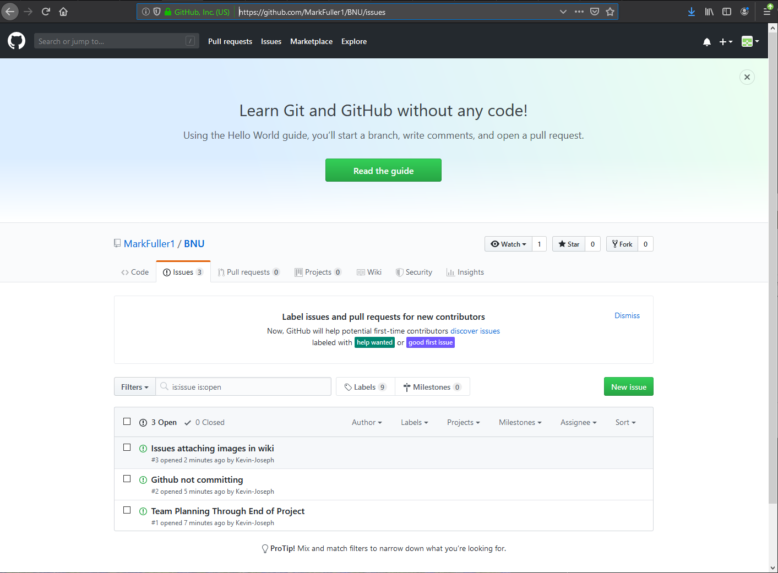
Issue Tracking
Please see our issue tracking repository on Github at the link below:
https://github.com/MarkFuller1/BNU/issues

Slide 34


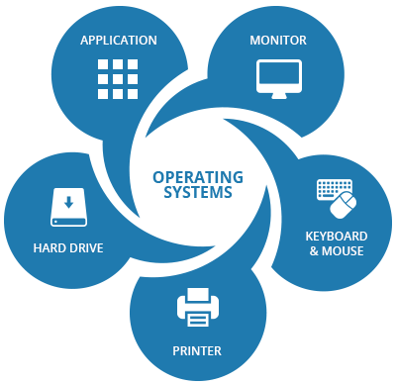
Actors
User Admin System

Slide 35
Timecard
Mark Fuller
09/10 - 1 Hour Use Case && Requirements List
09/11 - 1 Hour Use Case
09/12 - 1 Hour Use Case
09/13 - 1 Hour Use Case
09/14 - 1 Hour Use Case
09/15 - 1 Hour Use Case
09/16 - 1 Hour Use Case
09/17 - 1 Hour Use Case
09/18 - 1 Hour Use Case
09/19 - 1 Hour Use Case
09/20 - Domain Model
Connor Woodahl
09/10 - 1 Requirements List
09/11 - 1 Wireframes
09/12 - 1 Wireframes
09/13 - 1 Wireframes
09/14 - 1 Wireframes
09/15 - 1 Wireframes
09/16 - 1 Wireframes
09/17 - 1 Wireframes
09/18 - 1 Wireframes
09/19 - 1 Use Case Diagram && Traceability Matrix
09/20 - 1 Use Case Diagram && Domain Model
09/21 - 1 Use Case Diagram
Kevin Kulda
09/10 - 1 Requirements List
09/11 -
09/12 -
09/13 -
09/14 -
09/15 -
09/16 -
09/17 -
09/18 -
09/19 - 6 SSD
09/20 - 6 Domain Model && System Operations
09/21 - Presentation
12 hours = 33% points
12 hours = 33% points
13 hours = 33% points

Slide 36
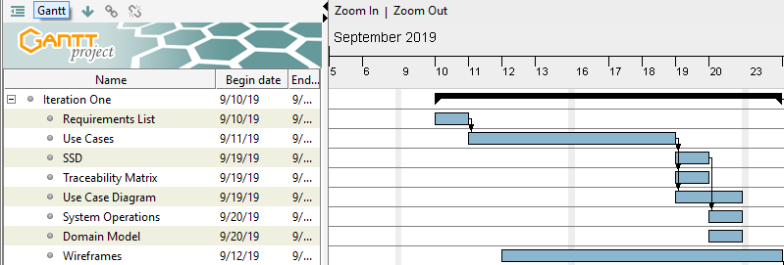
Teamwork Plan

